Slide 1
Intro to Web Development
Cascading Style Sheets

Slide 2
Agenda
What are Cascading Style Sheets (CSS)?
What is their purpose?
How to write CSS rules

Slide 3
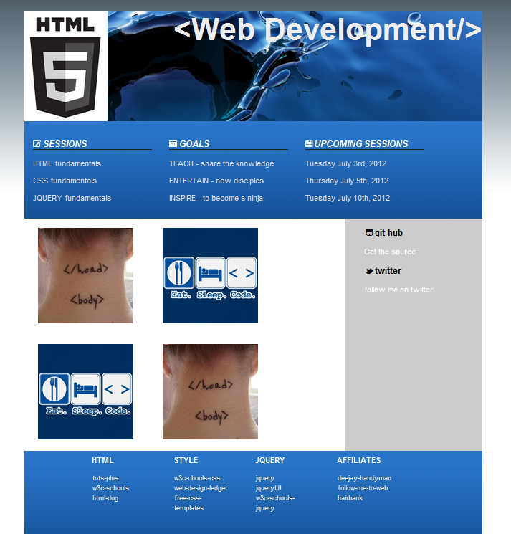
Demo Layout

Slide 4
What are CSS
HTML 4 (not this)
Set of rules to style your HTML document
Separate style from the content
Sets the look of the document
Fonts, colors, background, borders
Sets the layout of the document
Separates your document into components
Width, Height, Borders, Margin, Padding, Element Styles
Each component can also be styled differently

Slide 5
What are CSS
Inline <p style=“color: #59FF94;”>…</p>
Embedded
Inside the <head> element of your html
External to the html document (e.g. site.css)
External CSS can be shared across all pages of your website
This is not the jQuery Class but selectors knowledge carries over from this to jQuery

Slide 6
What are CSS
All browsers have a default CSS implementation, even your page does not have one.
You should use normalize.css to have a good starting point and your site is uniform across all browsers
CSS have an order of precedence
Inline
Embedded
Last External CSS, …
First External

Slide 7
Quick Demo
<style type=“text/css”>
body{
color: #0000FF;
}
p{
color: #FF0000;
font: “Arial”;
}
</style>
….
<p>
This is a simple CSS demo
</p>

Slide 8
Demo on Editor

Slide 9
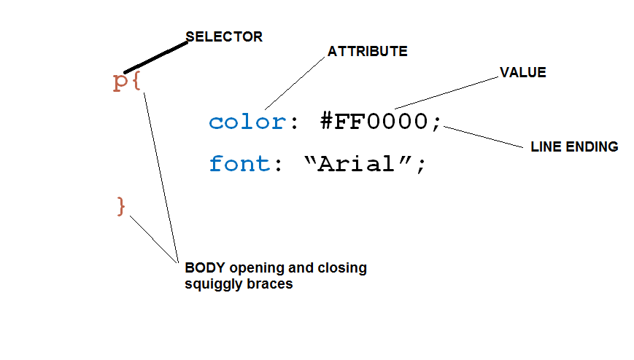
Makeup of a CSS Rule

Slide 10
Selectors
Type selectors
body{ ...} p{...} a{...}
div{..} span{...}
Class Selectors
.myclass{….}
Id Selectors
#myid{….}

Slide 11
Type and Class selector
<style type="text/css">
p{
color: #FF0000;
font-family: "Arial";
}
/*Notice that for class we use a dot prefix (.)*/
.product-description{
color: #00FF00;
background-color: #CCCCCC;
font-size: 2em;
}
</style>
This is some text outside of a paragraph.
<p>
This is some text within a styled paragraph.
</p>
<p class="product-description">
This is a product description. Notice how this product
has background and it has a different font color.
</p>

Slide 12
ID selector
<style type="text/css">
#sale-item-of-the-week{ background-color: #00FFFF; }
</style>
<p id=“sale-item-of-the-week">
This item works as seen on TV. It will go fast so get it while supplies last.
</p>

Slide 13
ID Selector
Can only appear once in your document (DOM)
Each element can have only on ID
It is more specific than the class selector
p { color: red; }
#item-of-the-week{ color: green; }
.myclass{ color: blue; }
<p class=“myclass” id=“item-of-the-week”>
Green wins because the id is more specific than p or .myclass

Slide 14
More About Selectors
Type selectors
body{ …. } p{….} a{….}
Class Selectors .myclass{….}
Id Selectors #myid{….}
Pseudo selectors a:hover{….} a:visited ul:first-child{….}
Selectors can be combined
body, h1, a{….}
Traversal – Descendants, Children,
.myclass a{…}, .myclass>a{…}, #myid a

Slide 15
Sidebar on Colors
#000000 #FFFFFF
Each group of two characters represents the colors Red, Green, Blue(RGB) respectively
The valid values are 0-9 and A-F
0,1,2,3,4,5,6,7,8,9,A,B,C,D,E,F
Each group has a value of 0-255 (00 – FF)
Color shorthand #ABC same as #AABBCC
http://www.w3schools.com/cssref/css_colors.asp

Slide 16
Color Quiz
What color is #000000 #000
What color is #FFFFFF #FFF
What color is #FF0000 #F00
What color is #00FF00 #0F0
What color is #0000FF #00F
What color is #FFEEEE #FEE
What value is greater?
A1 or 1A
11 or 1B
B1 or CF

Slide 17
PRACTICAL EXERCISE
Do Practical-exercise-1
Move Style to external
Demo an inline style

Slide 18
Attributes in CSS
Many attributes
Look (style)
Fonts (size, family, weight, color)
Background (color)
Border(thickness, style, color)
Text Decorations
Letter spacing
Text Alignment
Layout

Slide 19
Attributes in CSS
Layout and Positioning
Margin
Position
Padding

Slide 20
div and span
<div class=“promo-box”>
<h3>See my div in action</h3>
<p>Here are my <span class=“emphasis”>very important</span>contents</p>
</div>
<div class=“main-menu”>
<ul>
<li>Item 1</li>
<li>Item 1</li>
</ul>
<div/>

Slide 21
What we haven’t covered yet
Layouts
Images
Layout Structure
Responsive Web Design
HMTL 5 functionality

Slide 22
CSS Part 1 - Conclusion
Basic Structure
Selectors
Rules
Attributes
Value assignments
Style sheets can be inline, embedded, external
More on attributes
font, background, list styles

Slide 23
Resources
Wc3schools http://www.w3schools.com
HTML5 and CSS3 7th edition Castro & Hyslop
Questions

